Slide 1


Student Bulletin
13 July 2026
WEEK A
What’s on this week?
Clubs Timetable - Monday
BREAK 1 | BREAK 2 | AFTER SCHOOL
SPARX - all years in B1 | SPARX - all years in B1
 | Dance Club - Year 7 and 8 in DA1
 | Ball Games - all years on the 4G Pitch Health and Fitness Club - GIRLS ONLY in the Fitness Suite Basketball - Year 11 in the Gymnasium Dance Club - Year 7 and 8 in DA1

Slide 2
Student Bulletin
13 July 2026
WEEK A
What’s on this week?
Clubs Timetable - Tuesday
BREAK 1 | BREAK 2 | AFTER SCHOOL
SPARX - all years in B1 | SPARX - all years in B1 | Girls Football Club - all years on the 4G Pitch Rounders - all years on the Front Field WEEK B Badminton - Year 7 and 8 in the Sports Hall Health and Fitness Club - GIRLS ONLY in the Sports Hall
 | Ball Games - all years on the 4G Pitch Basketball - Year 9 and 10 in the Sports Hall, Sixth Form in the Gymnasium Health and Fitness Club - all years in the Fitness Suite WEEK B Dance Club - Year 9 in DA1

Slide 3
Student Bulletin
13 July 2026
WEEK A
What’s on this week?
Clubs Timetable - Wednesday
BREAK 1 | BREAK 2 | AFTER SCHOOL
SPARX - all years in B1 | SPARX - all years in B1 | Gymnastics Club - all years in the Gymnasium Health and Fitness Club - all years in the Fitness Suite Primary Dance Project - Dance Leaders in DA1
 | Cricket Club - all years in the Sports Hall Basketball - Year 11 in the Gymnasium
 | Drama Club - Year 7, 8 and 9 in DR2
 | Sketchbook Club - all years in AT1
 | Christian Union - all years in A13
Notes:
.

Slide 4
Student Bulletin
13 July 2026
WEEK A
What’s on this week?
Clubs Timetable - Thursday
BREAK 1 | BREAK 2 | AFTER SCHOOL
SPARX - all years in B1 | SPARX - all years in B1 | Netball - all years in the Sports Hall WEEK A Health and Fitness Club - GIRLS ONLY in the Sports Hall
 | Ball Games - all years on the 4G Pitch Basketball - Sixth Form in the Gymnasium Health and Fitness Club - all years in the Fitness Suite
 | LGBT+ Pride Club - all years in the Pride Club Room (A17)

Slide 5
Student Bulletin
13 July 2026
WEEK A
What’s on this week?
Clubs Timetable - Friday
BREAK 1 | BREAK 2 | AFTER SCHOOL
SPARX - all years in B1 | SPARX - all years in B1
 | Ball games - all years on the 4G Pitch Basketball - Year 11 in the Gymnasium Health and Fitness Club - all years in the Fitness Suite

Slide 6
Student Bulletin
13 July 2026
WEEK A
What’s on this week?
Assembly Rota
YEAR GROUP | ROOM
Year 7 | SPH
Year 8 | SPH
Year 9 | Hall
Year 10 | Hall
Year 11 | Sixth Form Centre

Slide 7

Student Bulletin
13 July 2026
WEEK A
Attendance Winners and
Best Attending Sixth Form Tutor Group:
SAB
86.18%
Sixth Form
Tutor Group:
DLM
86.15%
AWF
85.31%
1
2
CMA
3

Slide 8

Student Bulletin
13 July 2026
WEEK A

Slide 9

Student Bulletin
13 July 2026
WEEK A
If you are unwell during lesson time, or if there is any medication that needs to be taken, please let your teacher know and they will inform the First Aider, who will come to you.
Please remember: if you are bringing in medication, it needs to be given straight to a member of staff in Medical along with a permission slip.
You can find the permission slip on the college website
or ask at reception/in Medical if you can have one.

Slide 10

Student Bulletin
13 July 2026
WEEK A

Slide 11

Student Bulletin
13 July 2026
WEEK A
Red Box Project

Slide 12
Student Bulletin
13 July 2026
WEEK A
Library Timetable
The library is mostly a quiet reading and study area. However, to accommodate various uses a timetable has been implemented. Window seats remain quiet reading areas at all times, and behavior expectations are consistent with the rest of the college.
DAY | BREAK 1 | BREAK 2
Monday | Quiet Reading No computers, except for homework. No tabletop games. | Quiet Reading No computers, except for homework. No tabletop games.
Tuesday | Normal Break Computers and tabletop games available. | Tabletop Games Games may make space slightly louder if reading quietly. No computers, except for homework.
Wednesday | Quiet Reading No computers, except for homework. No tabletop games. | Tabletop Games Games may make space slightly louder if reading quietly. No computers, except for homework.
Thursday | Normal Break Computers and tabletop games available. | Tabletop Games Games may make space slightly louder if reading quietly. No computers, except for homework.
Friday | Homework Club/Quiet Reading No games. No computers, except for homework. | Homework Club/Quiet Reading No games. No computers, except for homework.

Slide 13

Student Bulletin
13 July 2026
WEEK A
Homework Club in the Library:
Friday Break 1 and 2
Do you need a quiet space to get your homework done?
Would you rather get it done in school so that you
don’t have to do it at home?
Why not complete it in the library every Friday, to free up
your weekends and avoid those detentions!
The library is calm and quiet on Fridays, and Mr B-D is
available to provide a little bit of support if needed.

Slide 14

Student Bulletin
13 July 2026
WEEK A

Slide 15

Student Bulletin
13 July 2026
WEEK A

Slide 16

Student Bulletin
13 July 2026
WEEK A

Slide 17
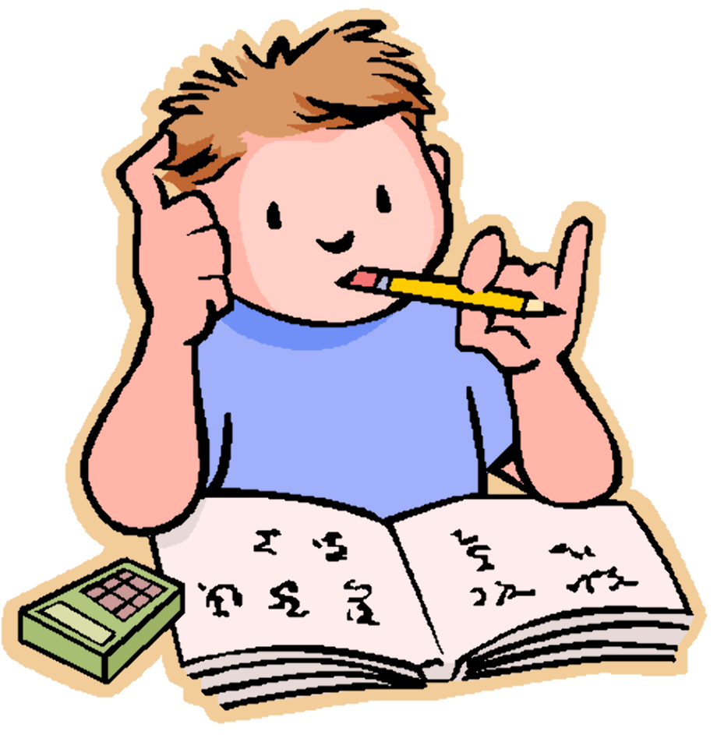
Student Bulletin
13 July 2026
WEEK A
HOMEWORK CLUB
Wednesday Lunchtime
IT3
Come along and get support with any homework you might be struggling with.

Slide 18

Student Bulletin
13 July 2026
WEEK A
Water Bottles
Please remember
to bring a water bottle
with you to college.

Slide 19

Student Bulletin
13 July 2026
WEEK A
It can be hard when you are dealing with your own mental health or that of others.
If you feel that you would like someone to talk to or some advice, please pop and see Mrs Hammond, our Well Being and Mental Health Lead, during break 1 (available every day).
For Young Carers this is available on Monday during break 2.

Slide 20

Student Bulletin
13 July 2026
WEEK A

Slide 21

Student Bulletin
13 July 2026
WEEK A
If you have misplaced any items, please visit
Lost Property at main reception so they can be returned
to their rightful owners.
Remember:
If your name is on the item, it is easier to return to you.

Slide 22

Student Bulletin
13 July 2026
WEEK A
PRAISE SHOP
Every Thursday in Student Reception at Break 2.

Slide 23

Student Bulletin
13 July 2026
WEEK A

Slide 24
Student Bulletin
13 July 2026
WEEK A

Slide 25

Student Bulletin
13 July 2026
WEEK A

Slide 26
Student Bulletin
13 July 2026
WEEK A

Slide 27
Student Bulletin
13 July 2026
WEEK A

Slide 28
Student Bulletin
13 July 2026
WEEK A

Slide 29

Student Bulletin
13 July 2026
WEEK A
STREATERIES PRICES

