Slide 1


Student Bulletin
4 May 2026
WEEK B
What’s on this week?
Clubs Timetable - Monday
BREAK 1 | BREAK 2 | AFTER SCHOOL
SPARX - all years in B1 | SPARX - all years in B1
 | Folk Band - all years in MU1 Year 9 Band - in MU2
 | Dance Club - Year 7 and 8 in DA1
 | Ball Games - all years on the 4G Pitch Health and Fitness Club - GIRLS ONLY in the Fitness Suite Basketball - Year 11 in the Gymnasium Dance Club - Year 7 and 8 in DA1
 | Geography - Year 11 in B13
 | Spanish - Year 11 in B12

Slide 2
Student Bulletin
22 September 2025
WEEK A
What’s on this week?
Clubs Timetable - Monday
BREAK 1 | BREAK 2 | AFTER SCHOOL
SPARX - all years in B1 | SPARX - all years in B1
 | Folk Band - all years in MU1 Year 9 Band - in MU2
 | Dance Club - Year 7 and 8 in DA1
 | Ball Games - all years on the 4G Pitch Health and Fitness Club - all years in the Fitness Suite
 | Warhammer - all years in AT2: Week B only

Slide 3
Student Bulletin
4 May 2026
WEEK B
What’s on this week?
Clubs Timetable - Tuesday
BREAK 1 | BREAK 2 | AFTER SCHOOL
SPARX - all years in B1 | SPARX - all years in B1 | Girls Football Club - all years on the 4G Pitch Netball - all years in the Sports Hall WEEK B Table Tennis - Year 7 and 8 in the Gymnasium Health and Fitness Club - GIRLS ONLY in the Sports Hall
 | Jazz - all years in MU1 Year 7 Band - in MU2 | English - Year 11 in B4 and B6
 | Ball Games - all years on the 4G Pitch Basketball - Year 9 and 10 in the Sports Hall Health and Fitness Club - all years in the Fitness Suite | Art Open House – Year 11 in AT1-AT3
 | Modern History - Year 11 in B14 WEEK A ONLY
 | Religious Studies - Year 11 in A13
 | Psychology - Year 11 in B17

Slide 4
Student Bulletin
22 September 2025
WEEK A
What’s on this week?
Clubs Timetable - Tuesday
BREAK 1 | BREAK 2 | AFTER SCHOOL
SPARX - all years in B1 | SPARX - all years in B1 | Girls Football Club - all years on the 4G Pitch Netball - Year 7-9 on the Top Courts WEEK B ONLY Pickleball - Year 7 and 8 in the Sports Hall
Drawing Club - all years in AT1 | Greenpower Kit Car Club - all years in TE1
 | Jazz - all years in MU1 Year 7 Band - in MU2
 | Dance Club - Year 7 and 8 in DA1
 | Drama Club - all years in DR2
 | Shakespeare Club - Year 9-13 in DR1
 | Ball Games - all years on the 4G Pitch Basketball - Year 11 in the Gymnasium Health and Fitness Club - all years in the Fitness Suite

Slide 5
Student Bulletin
4 May 2026
WEEK B
What’s on this week?
Clubs Timetable - Wednesday
BREAK 1 | BREAK 2 | AFTER SCHOOL
SPARX - all years in B1 | SPARX - all years in B1 | Football Club - Year 7 and 8 on the 4G Pitch Gymnastics Club - all years in the Gymnasium Health and Fitness Club - BOYS ONLY in the Fitness Suite
Year 10 Band - in MU2 | Year 11 Band - in MU2 | Sixth Form Band - in MU2
 | Cricket Club - all years in the Sports Hall Basketball - Year 11 in the Gymnasium | Maths - Year 11 in B2 and B10
 | Drama Club - Year 7, 8 and 9 in DR2 | Ancient History - Year 11 in B15 WEEK A ONLY
 | Sketchbook Club - all years in AT1 | Art Open House - Year 11 in AT1-AT3
 | Christian Union - all years in A13 | RS - Year 11 in A13
 | GCSE PE - Year 11 in PE1
 | French - Year 11 in B12
Notes:
.

Slide 6
Student Bulletin
4 May 2026
WEEK B
What’s on this week?
Clubs Timetable - Thursday
BREAK 1 | BREAK 2 | AFTER SCHOOL
SPARX - all years in B1 | SPARX - all years in B1 | Netball - all years in the Sports Hall WEEK A Health and Fitness Club - GIRLS ONLY in the Sports Hall
 | Ball Games - all years on the 4G Pitch Basketball – Sixth Form in the Gymnasium Health and Fitness Club - all years in the Fitness Suite | Science - Year 11 in SC1
 | Choir - all years in MU2
 | LGBT+ Pride Club - all years in the Pride Club Room (A17)
 | Computer Science - Year 11 in RM04
 | Design and Technology - Year 11 in TCA
 | Hospitality and Catering - Year 11 in TCA

Slide 7
Student Bulletin
22 September 2025
WEEK A
What’s on this week?
Clubs Timetable - Thursday
BREAK 1 | BREAK 2 | AFTER SCHOOL
SPARX - all years in B1 | SPARX - all years in B1 | Football Club - Year 7 and 8 on the 4G Pitch Netball - Year 7-9 on the Top Courts WEEK A
 | Ball Games - all years on the 4G Pitch Basketball - Year 11 in the Gymnasium Health and Fitness Club - all years in the Fitness Suite | Sixth Form Band - in MU2
 | GreenPower Kit Car Club - all years in TE1
 | Choir - all years in MU2
 | LGBT+ Pride Club - all years in the Pride Club Room (old counselling room)

Slide 8
Student Bulletin
4 May 2026
WEEK B
What’s on this week?
Clubs Timetable - Friday
BREAK 1 | BREAK 2 | AFTER SCHOOL
SPARX - all years in B1 | SPARX - all years in B1
Orchestra - all years in MU1 | Year 8 Band - in MU2
 | Ball games - all years on the 4G Pitch Basketball - Year 11 in the Gymnasium Health and Fitness Club - all years in the Fitness Suite
 | Modern History - Year 11 in B18
 | Business Studies - Year 11 in A16

Slide 9
Student Bulletin
22 September 2025
WEEK A
What’s on this week?
Clubs Timetable - Friday
BREAK 1 | BREAK 2 | AFTER SCHOOL
SPARX - all years in B1 | SPARX - all years in B1
 | Orchestra - all years in MU1 Year 8 Band - in MU2
 | Ball games - all years on the 4G Pitch Basketball - Year 11 in the Gymnasium Health and Fitness Club - all years in the Fitness Suite
 | Musical Theatre - All years in DA1

Slide 10
Student Bulletin
4 May 2026
WEEK B
What’s on this week?
Assembly Rota
YEAR GROUP | ROOM
Year 7 | SPH
Year 8 | SPH
Year 9 | Hall
Year 10 | Hall
Year 11 | Sixth Form Centre

Slide 11

Student Bulletin
4 May 2026
WEEK B
Attendance Winners and
Best Attending Sixth Form Tutor Group:
SAB
97.94%
Sixth Form
Tutor Group:
EMM/KAH
96.36%
SJM
96.32%
1
2
CMA
3

Slide 12
Student Bulletin
15 September 2025
WEEK B
This term’s Attendance Winners and
Best Attending Sixth Form Tutor Group:
Sixth Form
Tutor Group:
SMM
96.48%
RJP
96.10%
1
AWF
94.55%
2
CMA
85.48%
3

Slide 13
Student Bulletin
15 September 2025
WEEK B
Year 11 Science Revision
WHEN? | WHAT? | WHERE?
Thursday 3rd April After school | B10: The Human Nervous System | SC1
Thursday 24th April After school | P9: Motion | SC1

Slide 14

Student Bulletin
4 May 2026
WEEK B

Slide 15

Student Bulletin
4 May 2026
WEEK B
If you are unwell during lesson time, or if there is any medication that needs to be taken, please let your teacher know and they will inform the First Aider, who will come to you.
Please remember: if you are bringing in medication, it needs to be given straight to a member of staff in Medical along with a permission slip.
You can find the permission slip on the college website
or ask at reception/in Medical if you can have one.

Slide 16

Student Bulletin
4 May 2026
WEEK B

Slide 17
Student Bulletin
15 September 2025
WEEK B
Recent Student Council Updates
YOU SAID | WE DID
We wanted to adapt our uniform | New uniform: blue shirts (not tucked in), no ties, clear nose studs and jewellery acceptable when hidden
We were concerned about access to the toilets | New year group toilets, with monitors. New change over procedure to allow toilet visits between lessons
We wanted a calm area in the library during breaks | Mr B-D has set up a timetable for quieter times and activities in the library
We wanted ‘lighter’ reading books in tutor time | A new book was introduced for the end of Year 8: A Girl of Ink and Stars
We wanted a new display in the dining hall | The student bulletin is now displayed
We wanted the school to offer free sanitary products in girls’ toilets | Reintroduced the ‘Red Box Project’, providing free sanitary products in toilets and at access points

Slide 18

Student Bulletin
4 May 2026
WEEK B
Red Box Project

Slide 19
Student Bulletin
4 May 2026
WEEK B
Library Timetable
The library is mostly a quiet reading and study area. However, to accommodate various uses a timetable has been implemented. Window seats remain quiet reading areas at all times, and behavior expectations are consistent with the rest of the school.
DAY | BREAK 1 | BREAK 2
Monday | Quiet Reading No computers, except for homework. No tabletop games. | Quiet Reading No computers, except for homework. No tabletop games.
Tuesday | Normal Break Computers and tabletop games available. | Tabletop Games Games may make space slightly louder if reading quietly. No computers, except for homework.
Wednesday | Quiet Reading No computers, except for homework. No tabletop games. | Tabletop Games Games may make space slightly louder if reading quietly. No computers, except for homework.
Thursday | Normal Break Computers and tabletop games available. | Tabletop Games Games may make space slightly louder if reading quietly. No computers, except for homework.
Friday | Homework Club/Quiet Reading No games. No computers, except for homework. | Homework Club/Quiet Reading No games. No computers, except for homework.

Slide 20

Student Bulletin
4 May 2026
WEEK B
Homework Club in the Library:
Friday Break 1 and 2
Do you need a quiet space to get your homework done?
Would you rather get it done in school so that you
don’t have to do it at home?
Why not complete it in the library every Friday, to free up
your weekends and avoid those detentions!
The library is calm and quiet on Fridays, and Mr B-D is
available to provide a little bit of support if needed.

Slide 21
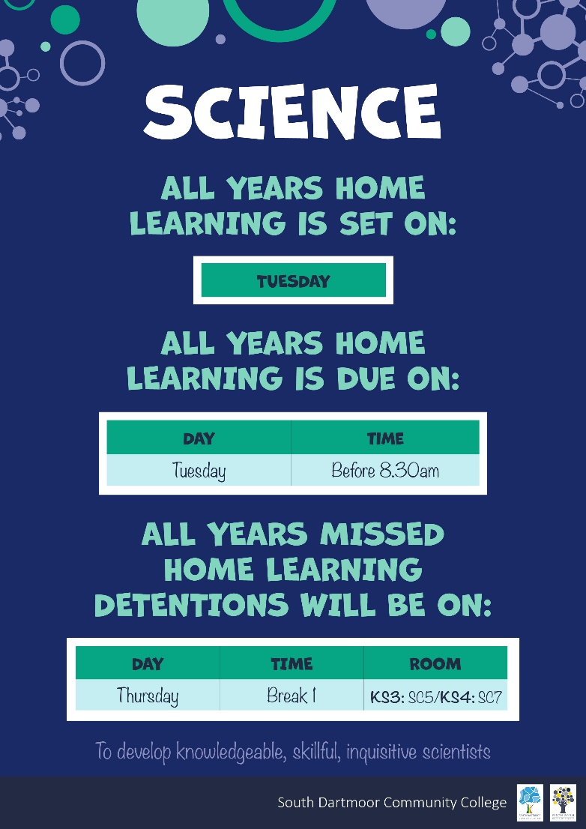
Student Bulletin
15 September 2025
WEEK B

Slide 22
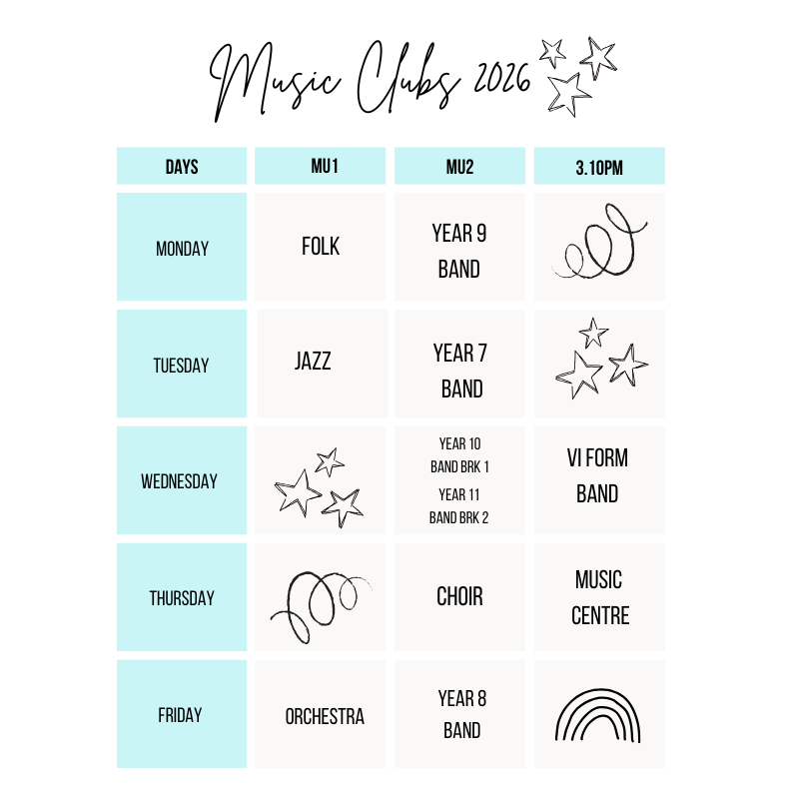
Student Bulletin
4 May 2026
WEEK B

Slide 23
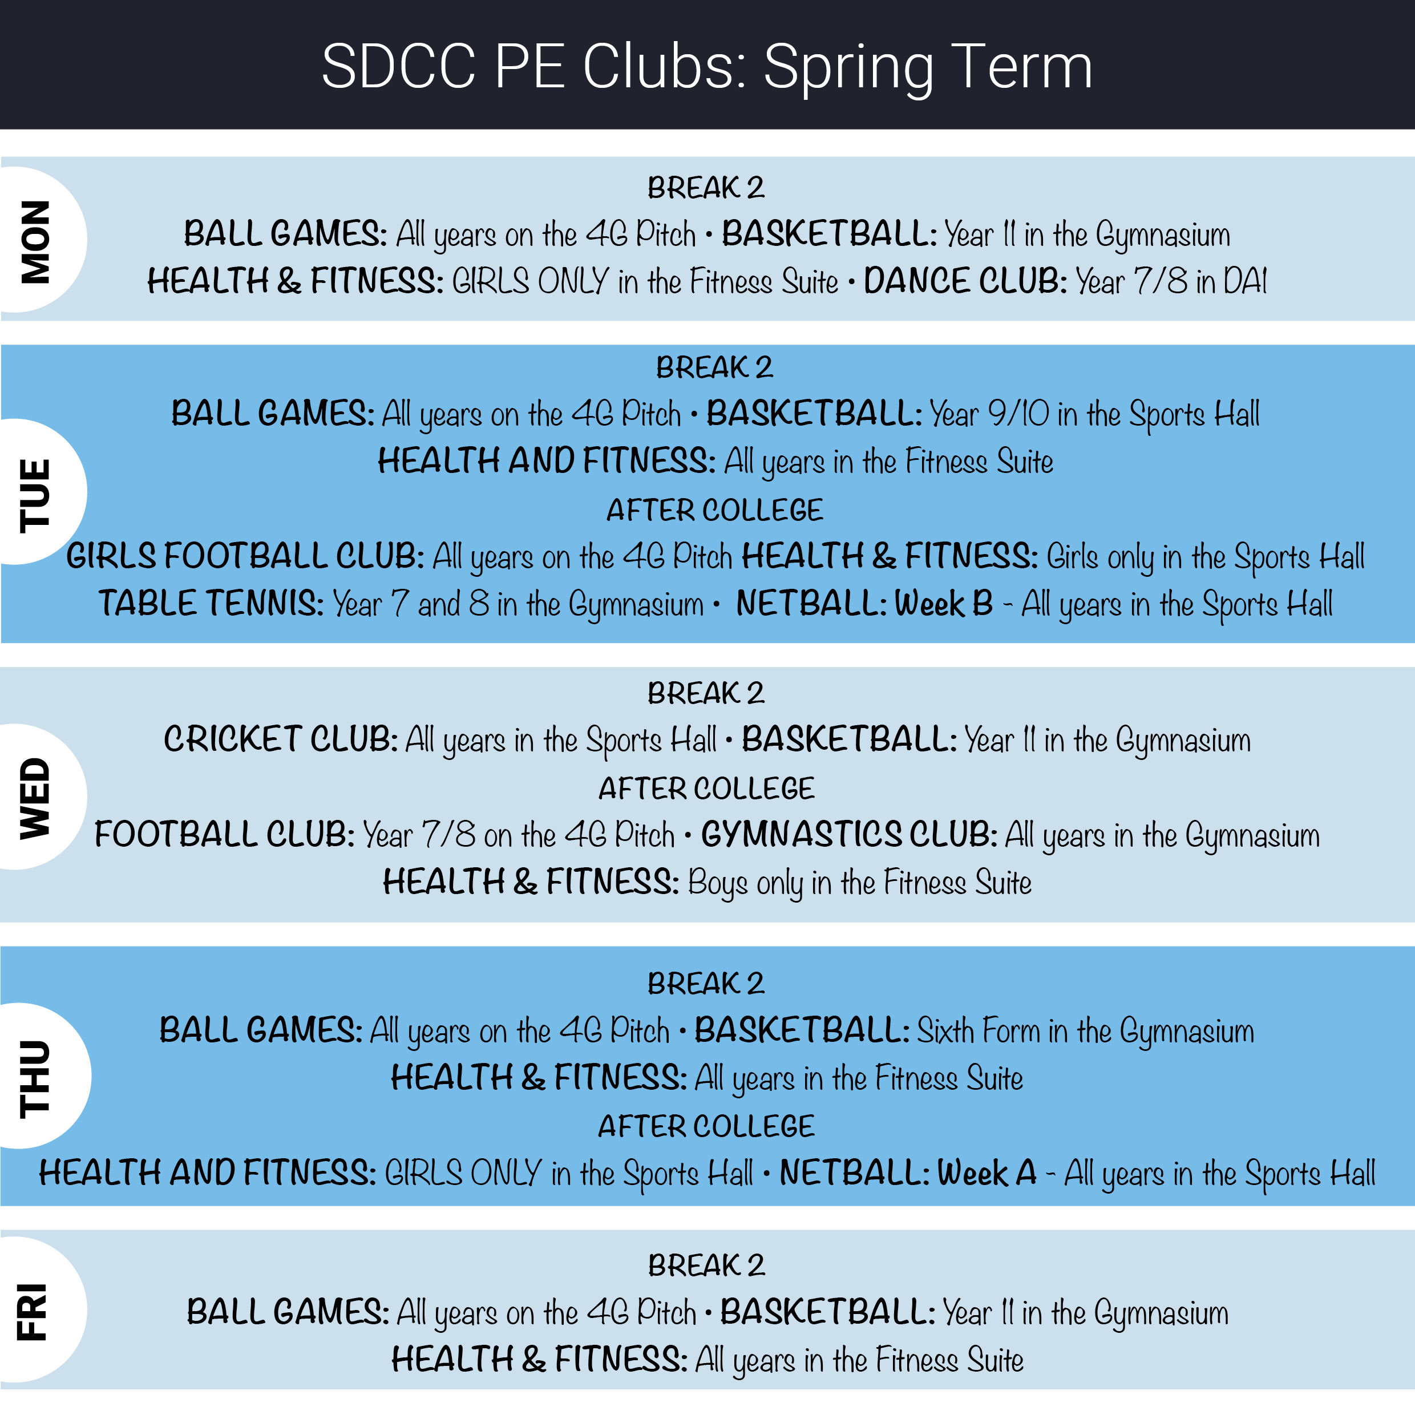
Student Bulletin
27 April 2026
WEEK A

Slide 24

Student Bulletin
4 May 2026
WEEK B
If you are interested or want more information, please see your catering teacher.

Slide 25

Student Bulletin
4 May 2026
WEEK B

Slide 26

Student Bulletin
4 May 2026
WEEK B

Slide 27

Student Bulletin
4 May 2026
WEEK B

Slide 28

Student Bulletin
4 May 2026
WEEK B
HOMEWORK CLUB
Wednesday Lunchtime
IT3
Come along and get support with any homework you might be struggling with.

Slide 29

Student Bulletin
15 September 2025
WEEK B
Do you paint or play Warhammer? Do you have no idea what it is but are interested in finding out?
Come along to AT2 on Monday Break 2 (Week B only).
Paint or play, it's up to you!

Slide 30

Student Bulletin
15 September 2025
WEEK B
Get a head start on your Fine Art, Graphics and Photography coursework this year in these 'Open House' sessions running in AT2, where you will have extra time to
access materials and the Art Department staff for support.
Bring your lunch, and bring your creativity!

Slide 31

Student Bulletin
15 September 2025
WEEK B

Slide 32

Student Bulletin
4 May 2026
WEEK B
Water Bottles
Please remember
to bring a water bottle
with you to college.

Slide 33

Student Bulletin
4 May 2026
WEEK B
It can be hard when you are dealing with your own mental health or that of others.
If you feel that you would like someone to talk to or some advice, please pop and see Mrs Hammond, our Well Being and Mental Health Lead, during break 1 (available every day).
For Young Carers this is available on Monday during break 2.

Slide 34

Student Bulletin
4 May 2026
WEEK B

Slide 35
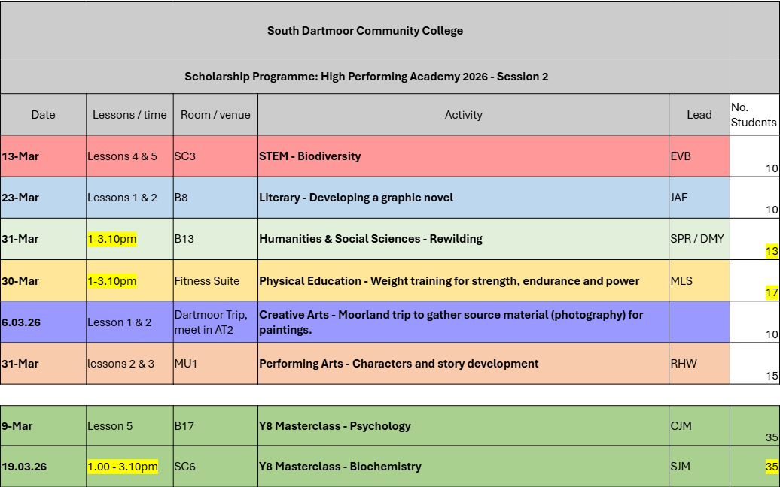
Student Bulletin
4 May 2026
WEEK B
HPA Scholarship Programme Timetable

Slide 36

Student Bulletin
4 May 2026
WEEK B
If you have misplaced any items, please visit
Lost Property at main reception so they can be returned
to their rightful owners.
Remember:
If your name is on the item, it is easier to return to you.

Slide 37

Student Bulletin
4 May 2026
WEEK B
PRAISE SHOP
Every Thursday in Student Reception at Break 2.

Slide 38

Student Bulletin
4 May 2026
WEEK B

Slide 39
Student Bulletin
4 May 2026
WEEK B

Slide 40

Student Bulletin
4 May 2026
WEEK B

Slide 41
Student Bulletin
4 May 2026
WEEK B

Slide 42
Student Bulletin
4 May 2026
WEEK B

Slide 43
Student Bulletin
4 May 2026
WEEK B

Slide 44

Student Bulletin
4 May 2026
WEEK B
STREATERIES PRICES

