Slide 1


Y7 Physical Education & Dance
2025-26
Student information

Slide 2






Meet the team:
Mr Slater
MLS
Mrs Avery-Wright
CAW
Mr Malone
KDM
Mr Vile
DPV
Miss Lovell
AJL
Mrs Slater
AMS
Head of PE
Dance

Slide 3
What are our values in Physical Education?
Inclusion
Confidence
Resilience
Performance

Slide 4


Slide 5
Positive changing rooms
Quick & Quiet change – the register will be taken 5 minutes after lesson start time.
Respect people's personal space
Be organised – all your uniform and school bag together in a neat pile / on a hook
Any students arriving after 8 minutes from the start of the lesson will be issued a lunchtime detention.
NO spray deodorant in changing rooms

Slide 6

SDCC PE kit
Lightweight polo - fleece and waterproof jacket optional
Shorts, skorts, tracksuit bottoms or sports leggings (plain black or navy blue)
White socks/indoor or SDCC sports socks/outdoor
Trainers or plastic studded footwear
No hoodies – Hoodies worn to PE lessons will be confiscated as per whole school policy.
Only plastic studded footwear can be worn on the 3G pitch

Slide 7
“I've forgotten my kit…”
2 weeks settling in period to support you with establishing routines
Items missing = 'kit warning' recorded on Class Charts. Parents/carers will be able to see this
No kit at all = lunchtime detention that day (or next day if issued during P5) - Parents/Carers will be able to see a kit fault detention has been issued
If you are struggling to get organised with your kit the PE department will help support you to get better – Please aim to talk to us in advance of the lesson.

Slide 8


Keeping your valuables safe:
Best advice – if it is really valuable to you – do you need it in school?
Changing rooms cannot always be locked
All valuables to be brought to your lesson
There are boxes at each space to place valuables
Collect at the end of the lesson
Only take your own valuables – do not collect for a friend

Slide 9
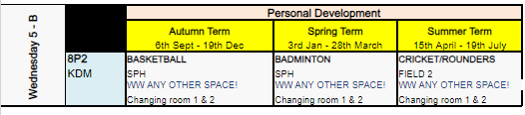
Reading a PE curriculum map
These are found in the PE corridor and school website. They tell you when your lessons are, what activity you are doing, your PE teacher, and your allocated changing room.
Write onto your timetable the activity, teacher, venue and changing room

Slide 10
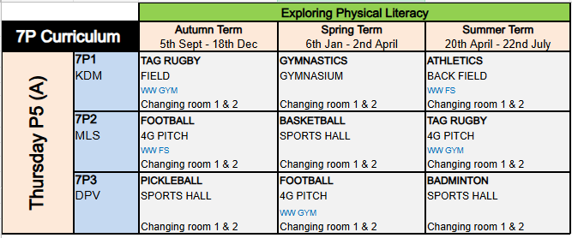
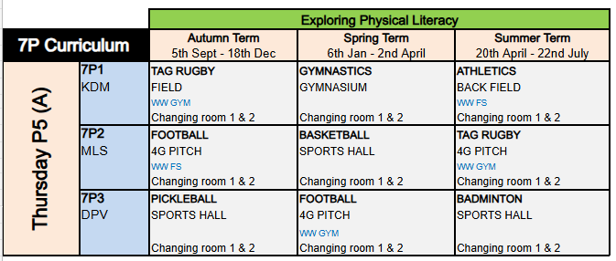
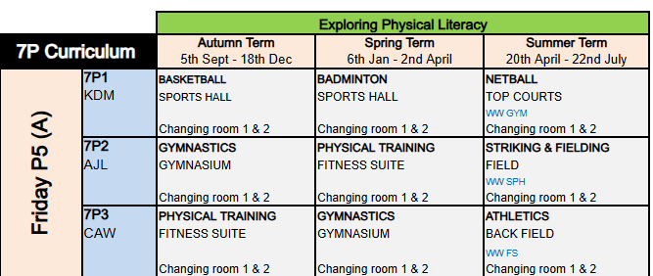
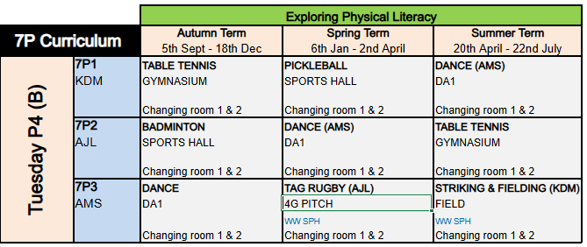
7P – 2025-26 PE activities

Slide 11
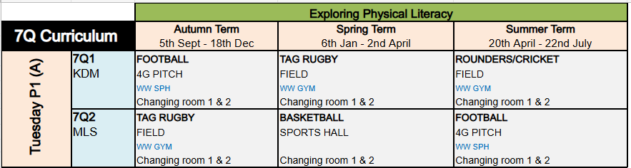
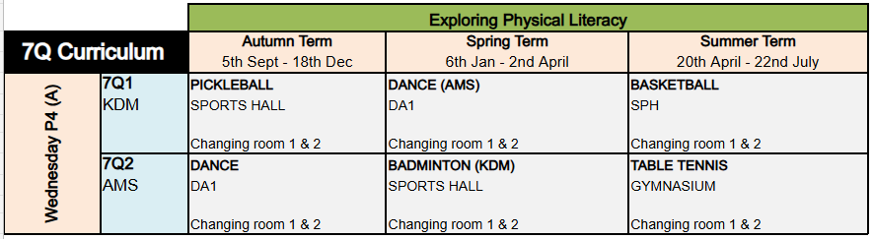
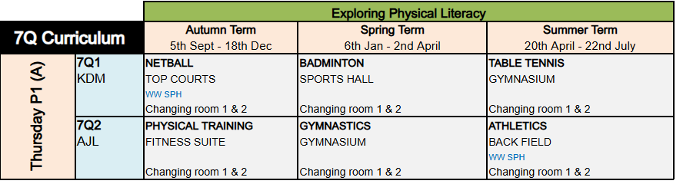
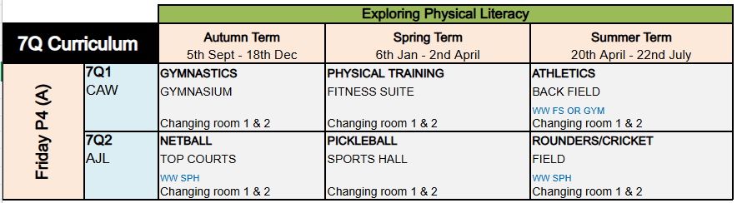
7Q – 2025-26 PE activities

Slide 12

What if I forget any of this information?
Ask a reliable friend
Come to the PE office
Look on the school website (Learning tab > Curriculum > PE)

