Slide 1


Y11 Physical Education & Dance
Student information
2025-26

Slide 2


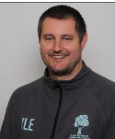


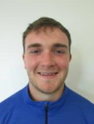
Meet the team:
Mr Slater
MLS
Mrs Avery-Wright
CAW
Mr Malone
KDM
Mr Vile
DPV
Miss Lovell
AJL
Mrs Slater
AMS
Head of PE
Dance

Slide 3
English
Maths
History
Science
Geography
Technology
MFL
Core PE

Slide 4
What are our values in Physical Education?
Inclusion
Confidence
Resilience
Performance

Slide 5
Positive changing rooms
Quick & Calm change – the register will be taken 5 minutes after lesson start time.
Respect people's personal space
Be organised – all your uniform and school bag together in a neat pile / on a hook
Students are expected to be sat ready for the register 8 minutes from start of the lesson at the latest
NO spray deodorant in changing rooms

Slide 6
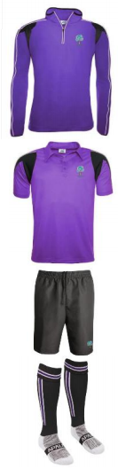
SDCC PE kit
Lightweight polo - fleece and waterproof jacket optional
Shorts, school logo skorts, tracksuit bottoms or sports leggings (plain black or navy blue)
White socks/indoor or SDCC sports socks/outdoor
Trainers or plastic studded footwear
No hoodies – Hoodies worn to PE lessons will be confiscated as per whole school policy.
Only plastic studded footwear can be worn on the 3G pitch

Slide 7
“I've forgotten my kit…”
2 weeks settling in period to support you with establishing routines
Items missing = 'kit warning' recorded on Class Charts. Parents/carers will be able to see this
No kit at all = lunchtime detention that day (or next day if issued during P5) - Parents/Carers will be able to see a kit fault detention has been issued
If you are struggling to get organised with your kit the PE department will help support you to get better – Please aim to talk to us in advance of the lesson.

Slide 8


Keeping your valuables safe:
Best advice – if it is really valuable to you – do you need it in school?
Changing rooms cannot always be locked
All valuables to be brought to your lesson
There are boxes at each space to place valuables
Collect at the end of the lesson
Only take your own valuables – do not collect for a friend

Slide 9
KS4 Core PE - Intent
Personal development – with a focus on attributes most useful for future careers
Develop strategic knowledge (what you want to achieve)
Develop tactical knowledge (how you will achieve it)

Slide 10
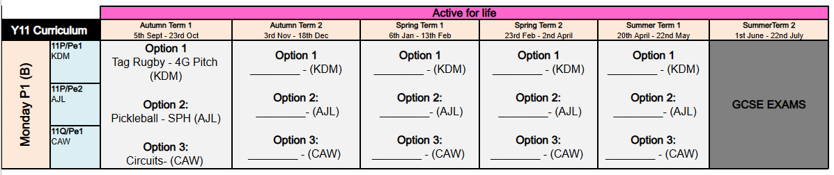
Y11 – Core PE timetable
New look Y11 Core PE Curriculum – rationale:
Provides students with more ownership over what activities they will do improving enjoyment and engagement
Units are shorter meaning you will do more activities over the year (you can pick an activity option more than once) reducing student fatigue and broadening knowledge / skill-sets
Enables personal development as well as tactical and strategic knowledge to be grown in a variety of sporting environments

