Slide 1



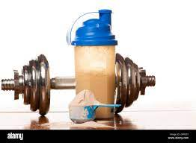


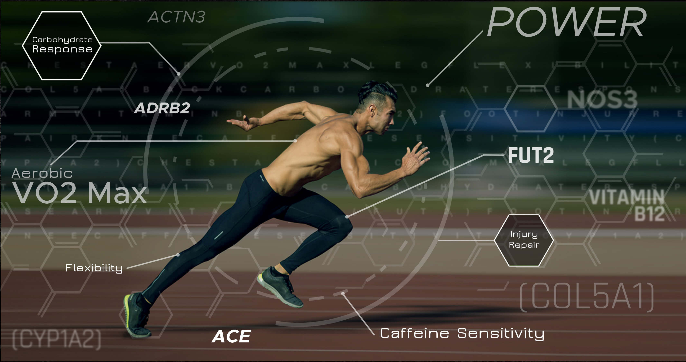




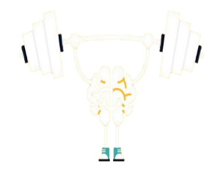
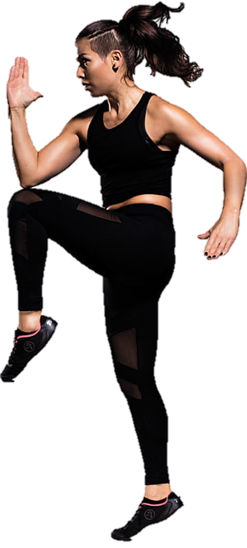
THE
CAMBRIDGE NATIONAL IN SPORTS STUDIES
LEARNING JOURNEY FOR STUDENTS
Unit:
The business of sport
Unit:
Practical skills in sport & physical activity
Unit:
Nutrition & diet for sport and exercise
Unit:
Organisation of sports events
Unit:
Sports organisation & development
Unit:
Health & fitness testing for sport & exercise
Unit:
Group exercise to music
Course wrap up & moderation
University
L3 CTEC in Sport & Physical Activity
January exams
Employment
CAREERS
Lifelong Physical Activity
13
Unit:
Physical activity for specific groups
Unit:
Sport & exercise sociology
Unit:
Performance analysis in sport & exercise
Unit:
Working safely in sport, exercise, health and leisure
Unit:
Sport & exercise psychology
Unit:
Working in active leisure facilities
Unit:
Sports coaching & activity leadership
Unit:
Improving fitness for sport & physical activity
Unit:
Sports Injuries and Rehab
Unit:
Body systems & effects of physical activity
January exams
L3 CTEC in Sport & Physical Activity
Students study one and a half units where they are assessed through practical and written assignments, as well as one external exam
3. Unit R187: Increasing awareness of Outdoor and Adventurous Activities
Types of OAA provision
Plan & evaluate an OAA session
Risk assess an OAA session
Demonstrate skills in an OAA session
4. Unit R184: Contemporary issues in sport
The role of National Governing Bodies in developing sport
The use of technology in sport
Review and revision
12
L2 CNAT in Sports Studies
Mock 1 & NEAs
Mock 2 & NEAs
Final exams
11
2. Unit R184: Contemporary issues in sport
Issues affecting participation in sport
The role of sport in promoting values
Impacts of hosting a global sporting event
1. Unit R185: Performance and leadership in sports activities
Performance of skills and techniques
Assessing strengths and weaknesses in sports performance
Methods to improve sports performance
Planning and leading a sports activity session
Risk assessing a sports activity session
Students study one and a half units where they are assessed through practical and written assignments
NEAs
Non-examination assessments (NEAs)
L2 CNAT in Sports Studies
Motor confidence, knowledge of healthy participation and rules, tactics, and strategies are developed through four different physical activities each unit
1. Autumn term
UNIT CONCEPTS
Determination – Equality – Critique – Sporting etiquette – Sportsmanship
Assessment
2. Spring term
UNIT CONCEPTS
Competing against yourself – Growth vs fixed mindset – Sportsmanship vs gamesmanship – Intrinsic & extrinsic motivation
3. Summer term
UNIT CONCEPTS
Effective collaboration – Problem solving – Planning & reflection – Effective decision making – Introvert vs extrovert – Fitness testing
10
Exploring Character Development
End of term assessment
End of term assessment
End of year assessment
9
3. Summer term
UNIT CONCEPTS
Emotional intelligence – Emotional regulation - Effective collaboration – Roles in sport – Inverted U Theory – Arousal control
2. Spring term
UNIT CONCEPTS
Resilience – Embracing failure – Marginal gains – Growth Mindset – Types of guidance
1. Autumn term
UNIT CONCEPTS
Verbal communication – non-verbal communication – Active listening – Open/closed questioning – Effective feedback
Motor confidence, knowledge of healthy participation and rules, tactics, and strategies are developed through four different physical activities each unit
End of year assessment
End of term assessment
End of term assessment
Exploring Personal Development
Motor confidence, knowledge of healthy participation and rules, tactics, and strategies are developed through four different physical activities each unit
1. Autumn term
UNIT CONCEPTS
Attitude – Effort – Work Ethic – Health & well-being – 3 stage warm-up – Types of stretching – Flexion & extension
2. Spring term
UNIT CONCEPTS
Competence – Skills & Techniques – Effective practice – Providing feedback – Main muscle groups – Components of Fitness
3. Summer term
UNIT CONCEPTS
Comfort zones – Embracing failure – Growth Mindset – Goal-setting - Hydration & physical performance
8
7
Exploring Physical Literacy
End of term assessment
End of term assessment
End of year assessment
Inclusion – Confidence – Resilience - Performance
Notes:
Optional units:
6
19
13
20
Mandatory:

