Slide 1



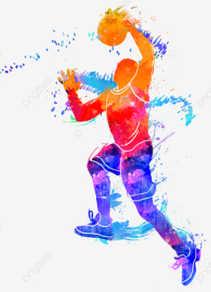





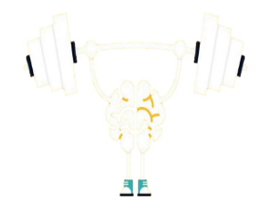
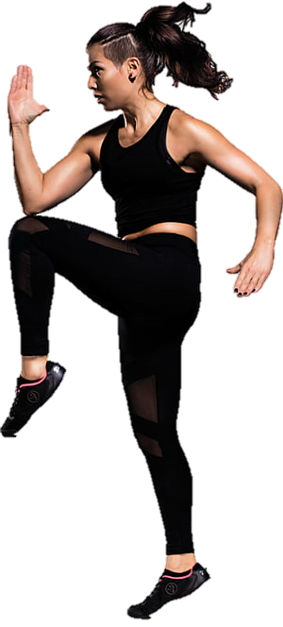
THE
GCSE PHYSICAL EDUCATION
LEARNING JOURNEY FOR STUDENTS
Physiological Factors Affecting Performance
Biomechanical principles – Newtons’ Laws of force & motion – Use of technology
2. Psychological Factors affecting Performance
Attribution theory – Confidence & self-efficacy – Leadership in Sport – Stress management
3. Socio-cultural factors
Ethics & deviance – Commertialisation & the media – Routes to sporting excellence – Modern technology in sport
University
A-level
Physical Education
Mock exam 1
Mock exam 2
EAPI assessment
Employment
CAREERS
Lifelong Physical Activity
13
3. Socio-cultural factors
Emergence & evolution of sport – Sport in the 21st century – Global sporting events
2. Psychological Factors affecting Performance
Skill Acquisition -
Skill classification – types of practice – learning theories – Stages of learning, guidance & feedback
Physiological Factors Affecting Performance
Skeletal & muscular systems – Cardiovascular & respiratory systems
Y12 assessment
In-class practice
In-class practice
A-level
Physical Education
Students study three units alongside practical coaching and assessment in both team and individual sports
1. Sports Psychology
Skill classification – Goal setting – Information processing model – types of feedback – Inverted U theory – Arousal control – Types of motivation
2. Socio-cultural Issues in Sport
Engagement patterns – Commercialisation of sport – Impact of technology – Hooliganism (causes & solutions) – Performance Enhancing Drugs
3. Health, Fitness & Well-Being
Social, physical & mental health – Effects of obesity – somatotypes – Energy balance – Sports nutrition - Hydration
Analysis and Evaluation coursework
Exam revision
12
GCSE Physical Education
In-class practice
Mock Exam
Analysis & Evaluation assessment
Mock Exam 2
Revision
11
4. Use of Data
Interpretation of Data - Quantitative and Qualitative Data
3. The Human Body & Movement in Sport (Con)
Respiratory system -Cardiovascular system – Aerobic vs anaerobic respiration - Effects of exercise
2. The Human Body & Movement in Sport
Skeletal & muscular systems – Movements at a joint – Levers – Planes & axes of movement
1. Physical Training
Fitness Testing – Types of Training – Principles of Training – The Season Cycle
Students study four units alongside practical coaching and assessment in both team and individual sports
In-class practice
In-class practice
In-class practice
GCSE Physical Education
Motor confidence, knowledge of healthy participation and rules, tactics, and strategies are developed through four different physical activities each unit
Assessment
1. Autumn term
UNIT CONCEPTS
Determination – Equality – Critique – Sporting etiquette – Sportsmanship
2. Spring term
UNIT CONCEPTS
Competing against yourself – Growth vs fixed mindset – Sportsmanship vs gamesmanship – Intrinsic & extrinsic motivation
3. Summer term
UNIT CONCEPTS
Effective collaboration – Problem solving – Planning & reflection – Effective decision making – Introvert vs extrovert – Fitness testing
10
Exploring Character Development
End of term assessment
End of term assessment
End of year assessment
9
3. Summer term
UNIT CONCEPTS
Emotional intelligence – Emotional regulation - Effective collaboration – Roles in sport – Inverted U Theory – Arousal control
2. Spring term
UNIT CONCEPTS
Resilience – Embracing failure – Marginal gains – Growth Mindset – Types of guidance
1. Autumn term
UNIT CONCEPTS
Verbal communication – non-verbal communication – Active listening – Open/closed questioning – Effective feedback
Motor confidence, knowledge of healthy participation and rules, tactics, and strategies are developed through four different physical activities each unit
End of year assessment
End of term assessment
End of term assessment
Exploring Personal Development
Motor confidence, knowledge of healthy participation and rules, tactics, and strategies are developed through four different physical activities each unit
1. Autumn term
UNIT CONCEPTS
Attitude – Effort – Work Ethic – Health & well-being – 3 stage warm-up – Types of stretching – Flexion & extension
2. Spring term
UNIT CONCEPTS
Competence – Skills & Techniques – Effective practice – Providing feedback – Main muscle groups – Components of Fitness
3. Summer term
UNIT CONCEPTS
Comfort zones – Embracing failure – Growth Mindset – Goal-setting - Hydration & physical performance
8
7
Exploring Physical Literacy
End of term assessment
End of term assessment
End of year assessment
Inclusion – Confidence – Resilience - Performance

