Slide 1




Civil Engineering
Gemma Davis BEng (Hons), Graduate Bridge Engineer, Exeter

Slide 2
What is Civil Engineering?
Highways
Water
Geotechnics
Structures

Slide 3
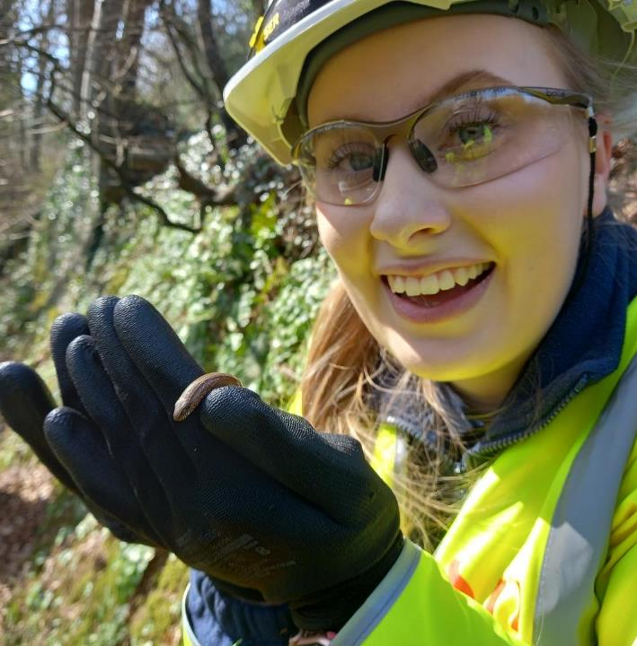
About me

Slide 4
My career history
BEng (hons) degree in Civil Engineering from Plymouth University
(2016-2020)
Completed an Industrial placement year at Hydrock as a Structural engineer
MSc Civil Engineering from Plymouth University.
(2020-2022)
Graduate Bridge Engineer at WSP since June 2021
Working towards Chartered Civil Engineer level

Slide 5
How do I get into Civil Engineering?
University
Degree Apprenticeship

Slide 6
My colleagues’ paths
University
Apprenticeship
Me – Plymouth University
Natasha – Portsmouth University
Zack – Plymouth University
Holly – UWE
Molly – Exeter University
Harvey - UWE

Slide 7
University Experiences
Gemma – Plymouth University
B – Maths
C – Chemistry
D – Physics
No gap year
MEng Civil (4 years)
Swapped to BEng in 3rd year then completed MSc during Covid.
Year industrial placement in building structures
Natasha – Portsmouth University
B – Maths
B – Physics
C – Chemistry
No gap year
MEng Civil (4 years)
Summer (3 months) between 3rd and 4th year in contracting
Zack – Plymouth University
C – Computing
C – Maths
C – Physics
Retook a year of A levels
MEng Civil (4 years)
No placement
A-Levels
Uni course
Placement?

Slide 8
University Experiences
Gemma – Plymouth University
BEng – 2020
MSc – 2022
Started June 2021
Graduate Engineer
Work towards chartership and promotion
4
3
2
1
Natasha – Portsmouth University
MEng – 2018
Started September 2018
Assistant Engineer (promoted 2020)
Work towards chartership and promotion
2
1
1
1
Zack – Plymouth University
MEng – 2021
Started September 2021
Graduate Engineer
Work towards chartership and gain experience
20
7
2
1
Graduated
Grad job
Current role
Next steps
Applications
Interviews
Offers
Jobs

Slide 9
Apprenticeship Experience
Holly – University of the West of England
Tried but failed so attempted a different route
Btec level 3 in Mechanical and electrical engineering ( completed 1 of 2 years)
Gained 90 credit diploma (equivalent to D* D*)
Started an HNC (higher national certificate) at level 4 and completed 2 years.
Option to do level 5 or find a job.
Moved to work for SCC as a CAD technician
Joined WSP in 2017 and started the degree apprenticeship at year 2 (of 5)
Graduating with BEng Civil Engineering Degree in 2022
MSc to follow, also parttime
A-levels
Next step

Slide 10
Advice from my team
Gemma
100% take the chance to do a placement if you go Uni, it was invaluable for me
Keep asking questions
If I was in school again I’d likely go down the apprenticeship route even though I loved uni.
Natasha
Choose the right fit for you, whether uni or apprenticeship make sure the company and university are right for you
Go to as many open days as you can to help your decision
Ask lots of questions
Zack
Study hard at A-levels if you go that route to take advantage
Get involved with as much as you can at Uni
If I could redo Uni I would do a placement
Holly
Don’t worry about having your path planned now
Try to get work experience in related fields to see if you like the work
Don’t give up on yourself if you fail, its not the end!

Slide 11
What do I Do?
Design work
Inspections
Assessments
Training

Slide 12
Inspections - Bridges

Slide 13
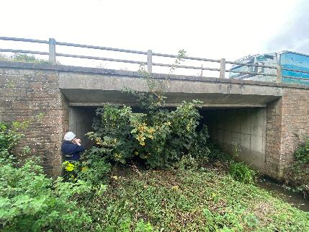
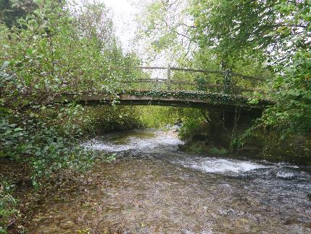
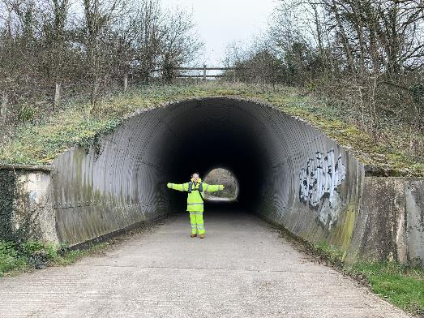
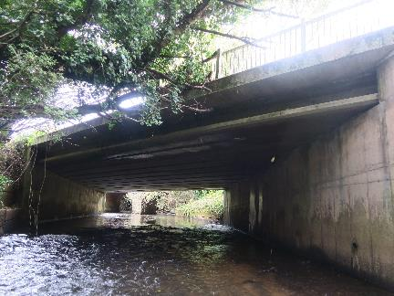
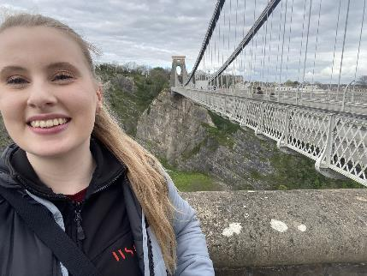

Slide 14
Inspections – Retaining walls

Slide 15
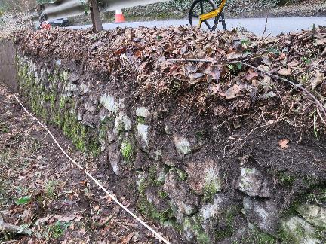
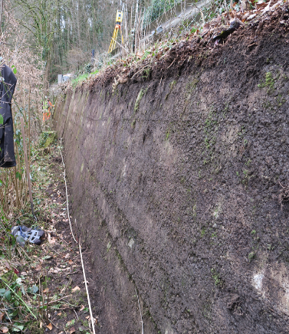
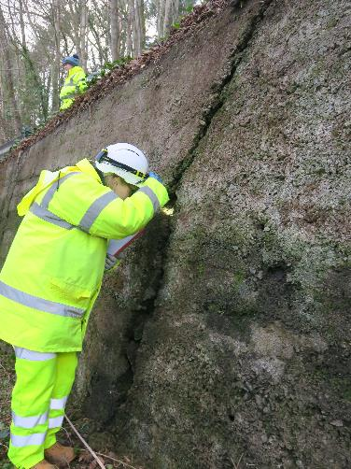
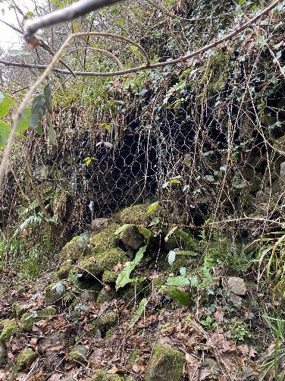
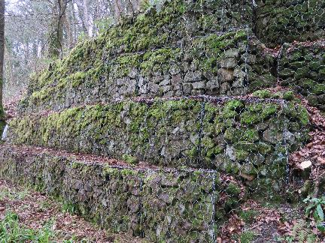
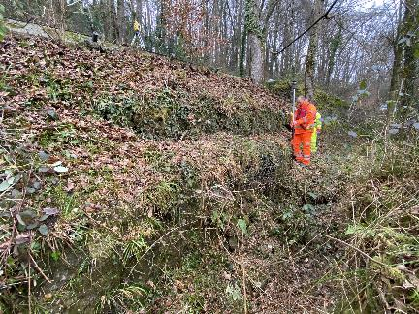

Slide 16
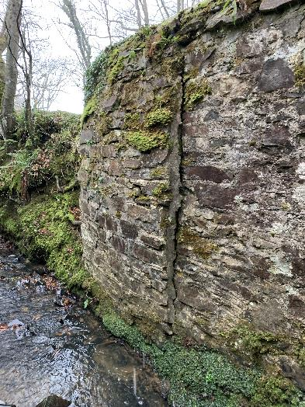
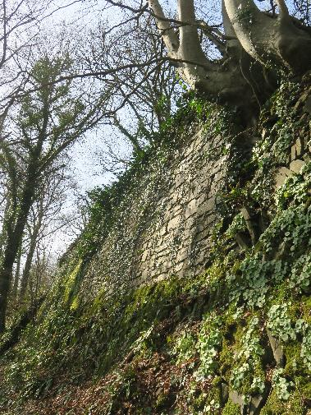
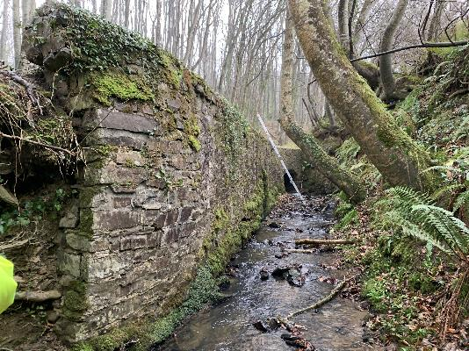
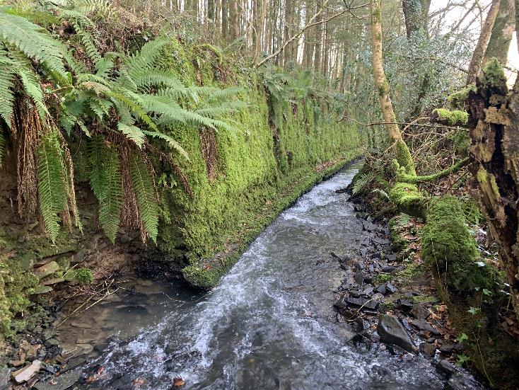

Slide 17
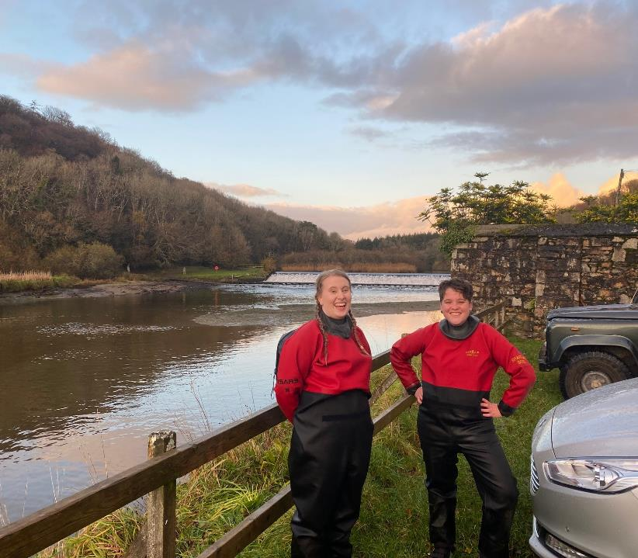
Training

Slide 18

Questions?

