Slide 1



Slide 2




English
We Were Liars
By E.Lockhart
Speak
By Laurie Halse Anderson
Brown Girl Dreaming
By Jacqueline Woodson

Slide 3

Maths
The Simpsons And Their Mathematical Secrets By Simon Singh

Slide 4



History
The Book Thief
By Mark Zusak
Private Peaceful
By Michael Morpurgo
The Diary Of A Young Girl
By Anne Frank

Slide 5


Music
Music Legends: Meet 40 Pop & Rock Stars
By Herve’ Guillieminot And Jerome Masi
Things You Wont Believe About Music
By Scott Cowie

Slide 6

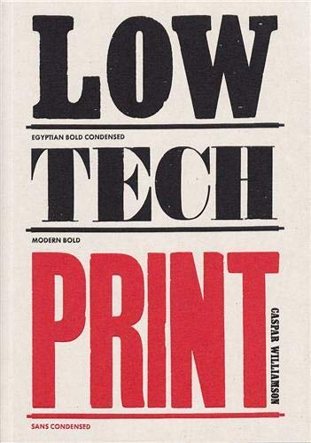

Art
Colour A Visual History
By Alexandra Loske
Low Tech Print
By Caspar Williamson
Hand Lettering
By Thy Doan Graves

Slide 7

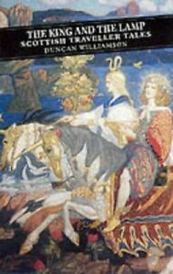


Extended Thinking
1984
by George Orwell
The King and the Lamp
by Duncan Williamson
Nothing but the truth
by Dick Lehr
Noone is to small to make a difference
by Greta Thunerg

