Slide 1
South Dartmoor
Learning Together
Welcome
Year 11 Support Evening
Strategies for exam success
Mental Health & Well Being

Slide 2
Notes:
Awareness of increasing issues related to the mental health and wellbeing of students
Issues include anxiety, anger, depression, panic attacks, self harming, confidence issues, sleep problems etc.

Slide 3
SDCC Mental Health and Well Being Survey
Year | Warwick-Edinburgh Scale | Potential wellbeing score
7 | 51 | 67%
8 | 50 | 65%
9 | 49 | 62%
10 | 48 | 61%
11 | 42 | 51%
A recent mental well-being survey of students (using the Warwick-Edinburgh Scale) identified that students’ potential well-being declines from 67% in year 7 to 51% in year 11.
Notes:
Academic pressure or pressure via social media?

Slide 4
SDCC Partnerships
Graham McDowell DHP HPD
Mindfulness Meditation. Awakening to the Present Moment. Solution Focused Hypnotherapy. Solution Focused Psychotherapy. Cognitive Behavioural Therapy. Energy healing incorporating The Emotion Code.

Slide 5
Evolving from the reptilian brain!
The answer is to stop allowing the monkey to take over!
Control our brain to use the neocortex which is the thinking more rational part of our brain.
Notes:
The answer to anxiety, anger, depression, panic attacks, self harming, confidence issues, sleep problems is to change the way that we think

Slide 6
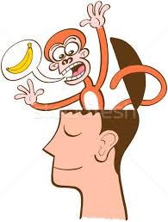
Is the monkey out to play?
Are you thinking something you don’t really want to be thinking…
Are you saying something you know you’re going to regret saying…
Are you behaving in a way you know you don’t really want to…
The biggest clues… If you’re really anxious or angry or stressed or raising your voice or getting annoyed or frustrated.... It’s the Monkey!
So…. The first step is AWARENESS…. Start becoming really AWARE of what’s going on within your MIND and BODY!
And then as soon as you become aware you’re becoming ‘triggered’ in some way, remember ‘PABLITO’

Slide 7
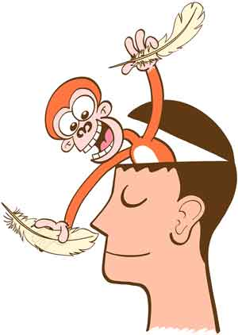
Our Monkey PABLITO (Spanish for little Paul)
P = Pause
A = Accept
B = Breathe
L = Look
I = Intention
T = Talk
O = Own
Notes:
Pablito can help you to change the way you think and feel and ultimately can influence your success and happiness both within the school and throughout your life!

Slide 8
PABLITO
P = Pause - When you notice you’re getting ‘Triggered’ e.g. Anxious, angry or stressed etc….. simply PAUSE!
A = Accept - When we become ‘Triggered’ we ‘resist’ the reality of a situation. So… simply ‘Accept’ that in this moment the situation is as it is…
B = Breathe - When ‘Triggered’ our breathing becomes shallow, this starves the brain of oxygen increasing our stress response. So focus on taking deep regular breaths and if possible use the 5 X 5 breathing technique! Breathe in (nose) for the count of 5…. Hold for count of 5… Breathe out (mouth) for count of 5… Then hold for count of 5… Then repeat for 5 cycles!

Slide 9
PABLITO
L = Look - Now you’ve gained back some emotional control, ‘Look’ again at the situation. It may well be that you still don’t like it… But instead of telling yourself “I don’t like it” “I don’t want” or ” It’s not fair” which makes you more stressed, simply ask yourself “Is there something I can do about this… or is there nothing I can do about this?”
I = Intention - Having considered what your options are, have a clear ‘Intention’ of how you’re going to move forward. If there is something you can do to change the situation then hold the ‘Intention’ to do what can be done without the need for anxiety, anger or frustration. However, there will be times when you still don’t like a situation, but realise there is actually nothing you can do to change it… in which case have a clear ‘Intention’ of ‘Accepting’ what cannot be changed! Again by ‘Accepting’ the reality of a situation we free ourselves from stress!

Slide 10
PABLITO
T = Talk - Pay close attention to how you ‘Talk’ to yourself in your mind and how you talk to others about situations. Remember…”It’s not the events in our lives that create the ‘perception’ of crisis… it’s how we choose to think about those events!” If you talk negatively to yourself and others about events, situations or people… guess what? You’re going to FEEL negative! Try and talk situations out with someone without moaning or criticising… instead focus on how well you’ve done either coming up with a solution to improve the situation or accepting it is as it is!
O = Own - Own your emotions! How often do you say or hear “She or He made me angry, annoyed or frustrated”? Well the reality is no one can MAKE you angry, or frustrated or annoyed etc. Take responsibility and recognise that when you blame others for how you feel, without realising it you are giving them power over you! What you’re effectively saying is “You decide if I’ll feel happy or angry today!”
Copyright © Graham McDowell 2017

Slide 11
Being Mindful
Notes:
Mindfulness practice 5 mins

Slide 12
Recommendation's: Mindfulness- Finding Peace in a Frantic World
Include free CD track of guided meditations
(used on the Mindfulness course)
By Mark Williams and Danny Penman

Slide 13
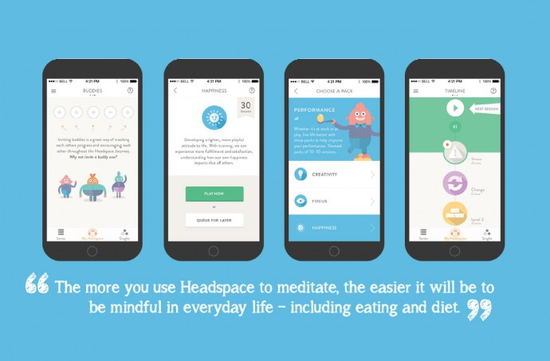
The Head Space App- Andy Puddicombe

Slide 14
Pupil Premium Support for Year 11 students
A free ‘Maths’ Packs includes, pens, pencils, rubber, ruler, protractor, compass, glue stick and clear pencil case suitable for exam use (£2.50 worth of stationary).
£1 Print credit (100 A4 black and white prints), this can increased if required.
Access to 30 Linx tablet/computers to support home learning. These tablets are on long term loan and are allocated to students based on referrals from Performance Leaders.
Free USB sticks, planners and scientific calculators when required.
Free revision guides and workbooks in Maths and English and a revision guide in Science.
Year 11 Pupil Premium students also get free core texts for English.

Slide 15
