Slide 1
South Dartmoor
Learning Together
Welcome
Year 11 Support Evening
Strategies for exam success
4. MFL

Slide 2
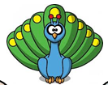
GCSE: What will I study?
Identity and Culture eg... self, family, friends, interests, socialising, daily life, food and drink, shopping, technology, celebrations, festivals, music, sport, tv and film. | Local, National International and Global areas of Interest eg... holidays, accommodation, travel and tourist transactions, directions, eating out, region, weather, sports and music events, environmental issues, campaigns and good causes. | Current and Future Study and Employment eg... school, subjects, rules and pressures, school trips, further study, volunteering, training, jobs, careers, using languages beyond the classroom.
Notes:
Brief overview of the topic themes for the new GCSE, with some examples of what comes within each broader topic (not a finite list).

Slide 3
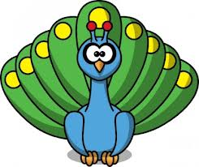
GCSE Spanish (Foundation) - HOW will I be assessed?
UNIT 1: Listening & Understanding | UNIT 2: Speaking
35 mins -(including 5 mins reading time) 40 marks | 7-9 mins + 10-12 mins preparation time – 60 marks
Section A – questions in English, to be answered in English Section B- questions in Spanish to be answered in Spanish | Role-play – 15 marks (2 mins) Photo card -15 marks (2 mins) General Conversation – 30 marks (3-5mins)
UNIT 3: Reading & Understanding | UNIT 4: Writing
45 mins -60 marks | 1 hour – 50 marks
Section A – questions in English, to be answered in English Section B- questions in Spanish to be answered in Spanish Section C – translation from Spanish into English (min 35 words) | Question 1– ss produce 4 sentences in response to a photo ( 8 marks) Question 2- ss write approx. 40 words in response to 4 brief bullet points ( 16 marks) Question 3– translation from English into Spanish (min 35 words) (10 marks) Question 4- (structured task) ss responds to 4 compulsory detailed bullet points - approx 90 words (16 marks)
25%
25%
25%
25%
Foundation Tier
Grades 5-1
New GCSE Grades: 9 – 1. 9 = A**, 5=top C / low B, 4 = low C
Notes:
Grade 5 will be positioned in the top third of the marks for a current Grade C and bottom third of a grade B.

Slide 4
GCSE French (Higher) - HOW will I be assessed?
UNIT 1: Listening & Understanding | UNIT 2: Speaking
45 mins (including 5 mins reading time)–50 marks | 10-12 mins + 10-12 mins preparation time -60 marks
Section A – questions in English, to be answered in English Section B- questions in Spanish to be answered in Spanish | Role-play – 15 marks (2 mins) Photo card -15 marks (3 mins) General Conversation – 30 marks) (5-7mins)
UNIT 3: Reading & Understanding | UNIT 4: Writing
1 hour -60 marks | 1 hour 15 mins – 60 marks
Section A – questions in English, to be answered in English Section B- questions in Spanish to be answered in Spanish Section C – translation from Spanish into English (min 50 words) | Question 1– (structured task)choice from 2 questions- ss responds to 4 compulsory detailed bullet points - approx 90 words (16 marks) Question 2- (open-ended task) choice from 2 questions- ss responds to 2 compulsory detailed bullet points - Approx 150 words (32 marks) Question 3– translation from English into Spanish (min 50 words) (12 marks)
25%
25%
25%
25%
Higher Tier
Grades 9-4
New GCSE Grades: 9 – 1. 9 = A**, 5=top C / low B, 4 = low C
Notes:
If a student just fails to achieve a grade 4 they will be awarded a grade 3. SS who fail to reach minimum standard for the allowed grade 3 will be awarded U.

Slide 5
How can you help your child to be a successful language learner?
By encouraging them to do the following:-
To always stay focussed in class
To get out their comfort zone and just have a go at speaking the language – nobody learns to swim by sitting on the side of the pool!
To complete their home learning on time and with a desire to do the best work they possibly can ( from this week all students should have a weekly writing or reading exercise to complete).
To experiment with finding the best strategies for learning vocab
To try and meet the target vocab score each week
To use the Quizlet online resource –weekly tests have been added for students to practice with online games and pronunciation practice (all students have the login details).
To use Linguascope –basic but essential vocab for GCSE practice –pronunciation and games to practice (all students have the login details).

Slide 6
The Importance of Vocabulary Learning
Which students did the best in this year’s reading and listening exams?
Those with a target grade of c (new grade 4) and above
Those who consistently achieved the target score in their vocab tests (some of whom had a target grade of d (new grade 3) or below)
Is just doing a quick ten minutes the night before enough revision, even if you consistently achieve the target grade
Yes, because you have passed the test.
No, because little and often is a more effective way of retaining the vocabulary
Should you be looking and revising old vocabulary lists
No!
Yes!.
This is probably the number one mistake students make. They concentrate on learning new material, and forget to review the older one.

Slide 7
Promoting vocab learning
All students have a weekly vocab test, and are set a weekly target score (this is differentiated according to the level of the group). Students must treat this seriously as a Home Learning task.
Students who do not achieve their target score are asked to complete a V1- a retest during a lunchtime.
Students who do not achieve their target score in the V1 retest must attend a compulsory lunchtime strategy workshop. The aim of this support session is to support individual students to find their own individual style of learning.
Encountering and learning new vocabulary is an integral part of each lesson. Students keep a vocab book, and review vocabulary regularly through a range of activities.
We need you to promote vocab learning at home just like you did with English spellings at Primary school! It is one of the easiest and most effective ways you can support your child with GCSE French and Spanish.
Notes:
What we do to promote vocab learning
7

Slide 8
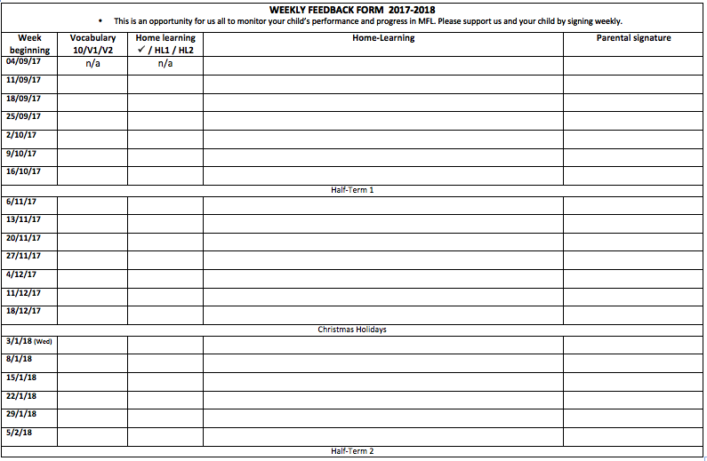
This is your chance to keep in touch with your child’s progress and to discuss their learning. Please sign each week so we know you know what’s going on!

Slide 9
Vocabulary Learning is key to progress in MFL
13. Use quizlet
1. Look for cognates and near cognates
12. Create your own Mind Palace!
11. Put the words into a song.
2. Re-order: most difficult at the top, easiest at the bottom.
10. Teach the words to someone else.
3. Look, cover, say, write, check
13 Ways to learn vocab!
Help your child to find the right combination of strategies that works for them
9. Make post-its with Spanish and English and put up in bedroom, toilet, bathroom, TV...
4. Get friend/family to test you
5. Record on a phone/computer/MP3
6. Break the list down and learn a few words every day
8. Make mini cards – Spanish on one side, English on the other to test yourself.
7. Think of a memory tag for the most difficult words.
Notes:
- Take feedback from groups, then compare to the methods on the slide (appear in order on clicks). Some can be combined – eg. 1. and 7, 2 and 10.... etc. Check ss know what each method is.
NB: when they do no.4 as experiment, this would mean no writing down.
No.12 – Mind Palace – as per Sherlock Holmes – similar to no.9, but each word is associated with a different item of furniture around the house.
Next, conduct the experiment. Assign a different vocab learning method or combination of methods to each group; give them time limit (eg. 20 mins) to learn the words on their handout or an agreed number of the words from the list (complete handout at end of ppt). Do test at end to see how each method got on.
HL is then to learn the words using each method or combination of method that each student chooses. Individual test in next Wednesday’s lesson.

Slide 10
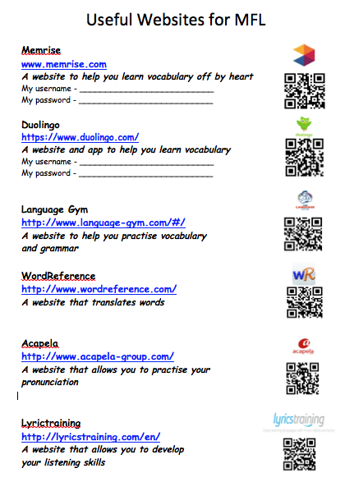
Quizlet
Username: mflsdcc
Password: welovevocab
Linguascope
Username: southdartm
Password: carotte
Normally £12.99 but £6.50 if purchased through parentpay at school. Students will need to sign up for one before a final order can be placed.

